Slide 1
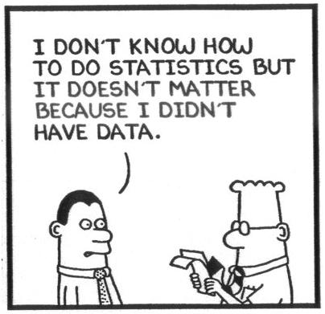
Measurement Error and Misclassification
EPI515 Fall 1
Lecture 4
Study Design in the Presence of Exposure Misclassification or Measurement Error
Updated 9.25.2017

Slide 2
Study design in the presence of misclassification
Fully validated design
Advantages: Easy to analyze, no questions about validity in terms
of (1) transportability, (2) form of the measurement error/misclassification model
Disadvantages: May be unethical or unfeasible; even when not,
cost may be prohibitive
2
Notes:
2

Slide 3
Main study/internal validation study design
Advantages: If VS is a random sample of full study (MS+VS), guaranteed to be transportable, more efficient than
main study / external validation study
Disadvantages: Almost always needs to be planned in advance,
although there are exceptions
3
Notes:
3

Slide 4
Main study/external validation study design
Advantages: Often, the only option for valid analysis of studies in
which there is measurement error or misclassification
Disadvantages: Transportability may be questionable, and cannot
be empirically verified; less efficient than the main study/internal
validation study design
4
Notes:
4

Slide 5
A given power would not uniquely determine . An additional criterion (cost) is needed.
Two design problems are most important
a. Minimize the cost of the study as a function of ,
subject to a minimum acceptable power ( )
b. Maximize the power of the study as a function of ,
subject to a fixed total cost.
A closely related, but less useful, problem is
c. Minimize subject to a fixed total cost.
(For a case-control study, is substituted with )
5
Notes:
5

Slide 6
 | Main Study Data | Method for dealing with ME | Measurement error assumption | Criteria of optimal design
Greenland (1988) | 2X2 table | Matrix method | Differential and non-differential | Minimum variance subject to cost considerations
Reilly (1996) | 2X2 table (and categorical exposure) | MLE | Differential and non-differential | Maximize precision for a fixed total budget or minimize the study cost given a desired precision
Buonaccorsi (1990) | Binary outcome, continuous E | MLE (Logistic regression) | jointly normal and homoscedastic | Minimize the variance subject to cost considerations
Spiegelman and Gray (1991) | Binary outcome, continuous E | MLE (Logistic regression) | Classical additive ME | Minimize cost, subject to a specified discriminatory power
Rosner et al. (1992) | Binary outcome, continuous exposure | Logistic regression, Regression Calibration | Classical additive ME

Slide 7
Note that can be rewritten as ,
where (proportion of validation study)
Greenland (Greenland, 1988) addressed problem (c) in detail for
case-control studies on the matrix method estimator, and, in his Appendix, provides the formulas to address problem (c) in cohort studies.
Greenland S. (1988) Statistical uncertainty due to misclassification- implications for validation
substudies. Journal Of Clinical Epidemiology 41:1167-1174.
7
Notes:
7

Slide 8
Greenland S. (1988)
To solve this problem for case-control studies, additional features of
the study must be specified. These include:
(Of course, it can be assumed that misclassification is
non-differential)
Or, although Greenland didn’t provide the formulas in these terms,
Bayes theorem can be used to solve for as a
function of , , and
Or, the problem could be re-parameterized in terms of
and , and
8
Notes:
8

Slide 9
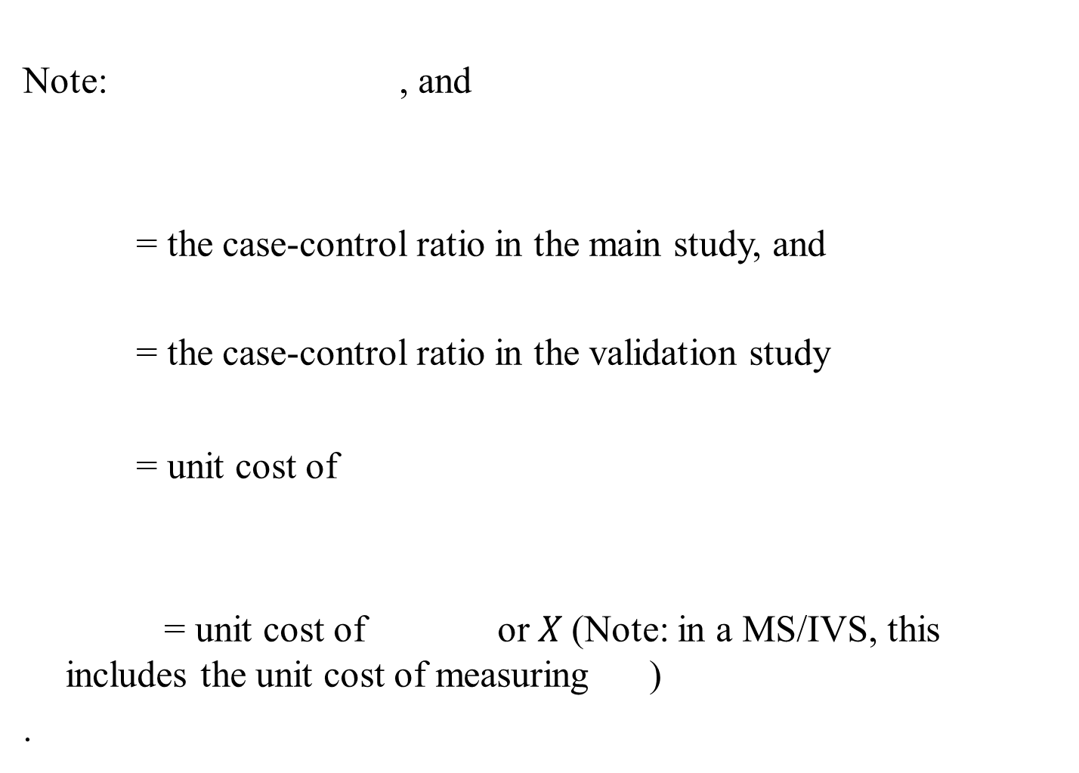
Notes:
9

Slide 10
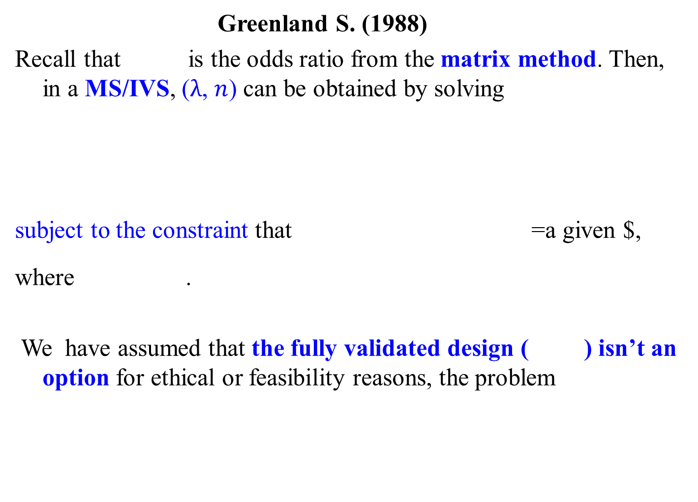
Greenland S. (1988)
Recall that is the odds ratio from the matrix method. Then, in a MS/IVS, ($λ$, $n$) can be obtained by solving
subject to the constraint that =a given $,
where .
We have assumed that the fully validated design ( ) isn’t an option for ethical or feasibility reasons, the problem
10
Notes:
10

Slide 11
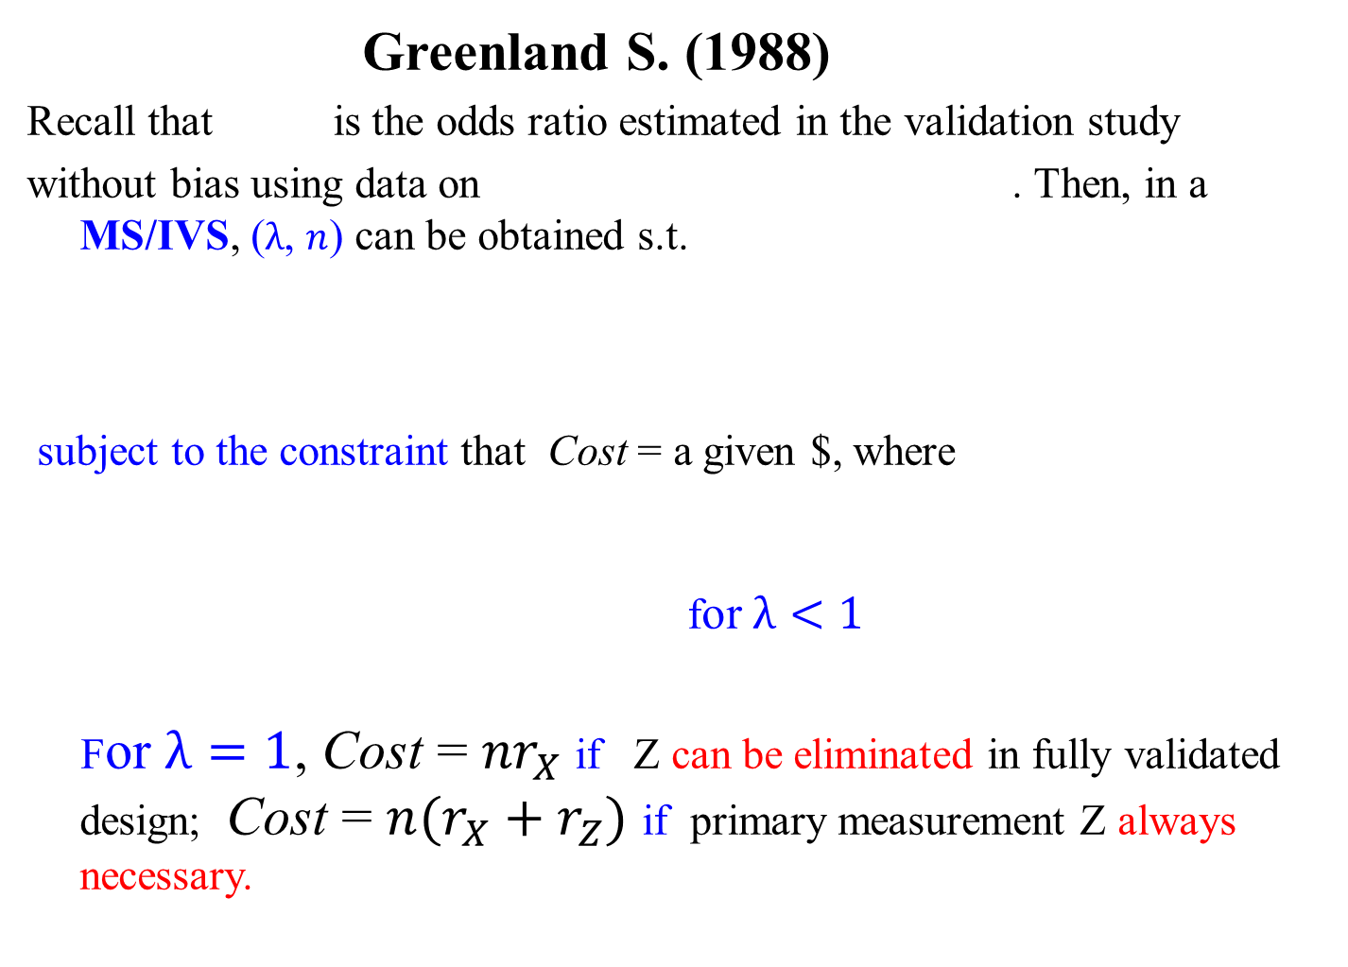
Greenland S. (1988)
Recall that is the odds ratio estimated in the validation study
without bias using data on . Then, in a MS/IVS, ($λ$, $n$) can be obtained s.t.
subject to the constraint that Cost = a given $, where
for $λ<1$
For $λ=1$, Cost = ${nr}_{X}$ if Z can be eliminated in fully validated design; Cost = ${n(r}_{X}+r_{Z})$ if primary measurement Z always necessary.
11
Notes:
11

Slide 12
Table 4: Optimal proportion for validation substudy as a function of the cost ratio
(assuming parameter values equal values observed in the SIDS data)
 | <=3 | 4 | 5 | 6 | 8 | 10
I. Assuming differential misclassification !!!
A. Assuming primary measurement always necessary
 | 1.00 | 0.87 | 0.77 | 0.71 | 0.61 | 0.55
ARE at | 1.00 | 1.00 | 0.99 | 0.98 | 0.97 | 0.95
Relative | 1.00 | 0.90 | 0.81 | 0.75 | 0.65 | 0.59
B. Assuming primary measurement can be eliminated if
and ARE=1.00 for all R <=14
II. Assuming nondifferential misclassification
A. Assuming primary measurement always necessary
 | 1.00 | 0.11 | 0.07 | 0.06 | 0.04 | 0.04
ARE at | 1.00 | 0.90 | 0.80 | 0.72 | 0.60 | 0.52
Relative | 1.00 | 0.27 | 0.22 | 0.19 | 0.15 | 0.13
B. Assuming primary measurement can be eliminated if
 | 1.00 | 1.00 | 0.07 | 0.06 | 0.04 | 0.04
ARE at | 1.00 | 1.00 | 0.96 | 0.84 | 0.68 | 0.57
Relative | 1.00 | 1.00 | 0.27 | 0.23 | 0.16 | 0.14
* Asymptotic efficiency of design with , relative to design with . Ratio of study size when to study size when (assuming the same expenditure for measurement in both designs).
What is the relative cost of the measurement, , for your study?
For NHS, it has been estimated at 500.
12
Notes:
12

Slide 13
In case-control studies, with relatively low cost ratios (medical records vs. self-report), the fully validated design is often optimal
Differential vs. non-differential misclassification assumption has a big impact on the design.
13
Notes:
13

Slide 14
 | MS Data | Method for dealing with ME | Measurement error assumption | Criteria of optimal design
Greenland (1988) | 2X2 table | Matrix method | Differential and non-differential | Minimum variance subject to cost considerations
Reilly (1996) | 2X2 table (and categorical exposure) | MLE | Differential and non-differential | Maximize precision for a fixed total budget or minimize the study cost given a desired precision
Buonaccorsi (1990) | Binary outcome, continuous E | MLE (Logistic regression) | jointly normal and homoscedastic | Minimize the variance subject to cost considerations
Spiegelman and Gray (1991) | Binary outcome, continuous E | MLE (Logistic regression) | Classical additive ME | Minimize cost, subject to a specified discriminatory power
Rosner et al. (1992) | Binary outcome, continuous exposure | Logistic regression, Regression Calibration | Classical additive ME

Slide 15
Reilly M. (1996)
Software for optimal study design for a binary outcome variable and a
binary misclassified exposure is available here
http://www.meb.ki.se/~marrei/software/ (Reilly, 1996).
This software uses the MLE, for the MS/IVS design for both the case control and cohort studies. The criterion is to maximize precision for a fixed total budget or minimize the study cost given a desired precision.
We know from Lecture 2 that in the MS/IVS under differential misclassification assumption, the MLE is the inverse matrix method (Lyles, 2002) and that the efficiency loss from using the matrix method can be considerable.
Reilly M. (1996) Optimal sampling strategies for two-stage studies. American Journal of
Epidemiology 143:92-100.
Lyles R.H. (2002) A note on estimating crude odds ratios in case-control studies with differentially
misclassified exposure. Biometrics 58:1034-1036.
15
Notes:
15

Slide 16
More complex designs have been developed in which the
validation study proportions vary by , , and even
(Reilly, 1996; Tosteson and Ware, 1990) and others.
They have rarely if ever been used in practice.
Tosteson T.D., Ware J.H. (1990) Designing a logistic regression study using surrogate measures for
exposure and outcome. Biometrika 77:11-21.
16
Notes:
16

Slide 17
 | MS Data | Method for dealing with ME | Measurement error assumption | Criteria of optimal design
Greenland (1988) | 2X2 table | Matrix method | Differential and non-differential | Minimum variance subject to cost considerations
Reilly (1996) | 2X2 table (and categorical exposure) | MLE | Differential and non-differential | Maximize precision for a fixed total budget or minimize the study cost given a desired precision
Buonaccorsi (1990) | Binary outcome, continuous E | MLE (Logistic regression) | jointly normal and homoscedastic | Minimize the variance subject to cost considerations
Spiegelman and Gray (1991) | Binary outcome, continuous E | MLE (Logistic regression) | Classical additive ME | Minimize cost, subject to a specified discriminatory power
Rosner et al. (1992) | Binary outcome, continuous exposure | Logistic regression, Regression Calibration | Classical additive ME

Slide 18
Buonaccorsi (1990)
Design for logistic regression
Buonaccorsi (Buonaccorsi, 1990) derived a closed form expression for the
optimal validation study proportion, , in the MS/IVS design for a logistic regression model where is normally distributed with constant variances. Then,
which is the optimal validation study proportion assuming that at least some
participants will be validated, where is the unit cost of measuring the
outcome. It is based on the MLE. The criterion is to minimize the variance of the log(OR) estimator subject to cost considerations.
Buonaccorsi J.P. (1990) Double sampling for exact values in the normal discriminant model with
application to binary regression. Communications in Statistics-Theory and Methods 19:4569-4586.
18
Notes:
18

Slide 19

Note that ,
if it is easier to supply values for these parameters which might often
be the case.
Now the variance of corrected for measurement error in the
MS/IVS design given by needs to be compared to the variance of
from the fully validated design. For , Buonacorrsi
gives
where , with Cost = a given $
19
Notes:
19

Slide 20
For , the optimal MS/IVS needs to be compared to the fully
validated design to find the final .
and then is 1 if < ,
otherwise .
Software is not available but perhaps we will write it for next year!
20
Notes:
20

Slide 21
Buonaccorsi observed the following:
The optimal proportion in the validation study increases as
increases.
This can happen as the increases, and as from either direction.
The optimal proportion in the validation study increases as decreases and for small , the optimal design is often the fully validated design
The optimal proportion in the validation study is not as sensitive to
changes in as it is to
21
Notes:
21

Slide 22
 | MS Data | Method for dealing with ME | Measurement error assumption | Criteria of optimal design
Greenland (1988) | 2X2 table | Matrix method | Differential and non-differential | Minimum variance subject to cost considerations
Reilly (1996) | 2X2 table (and categorical exposure) | MLE | Differential and non-differential | Maximize precision for a fixed total budget or minimize the study cost given a desired precision
Buonaccorsi (1990) | Binary outcome, continuous E | MLE (Logistic regression) | jointly normal and homoscedastic | Minimize the variance subject to cost considerations
Spiegelman and Gray (1991) | Binary outcome, continuous E | MLE (Logistic regression) | Classical additive ME | Minimize cost, subject to a specified discriminatory power
Rosner et al. (1992) | Binary outcome, continuous exposure | Logistic regression, Regression Calibration | Classical additive ME

Slide 23

Spiegelman and Gray (1991)
(Spiegelman and Gray, 1991) considered optimal design when Z|X is
normal and homoscedastic, in contrast to the setting considered by
Buonaccorsi (Buonaccorsi, 1990), which assumes are jointly
normal and homoscedastic. The latter distributional assumptions make
more sense for a case-control study, while the former make more sense
for a cohort study.
Spiegelman D., Gray R. (1991) Cost-efficient study designs for binary response data with Gaussian
covariate measurement error. Biometrics 47:851-869.
23
Notes:
23

Slide 24
Spiegelman and Gray (1991)
Considered MS/IVS, MS/EVS and fully validated studies, based on MLE.
Criterion is to minimize cost, subject to a specified discriminatory power. That is, the optimal design satisfies the power requirements of two hypothesis testing setups: First plays the role of the null and plays the role of the alternative; then is the null and is the alternative.

Slide 25
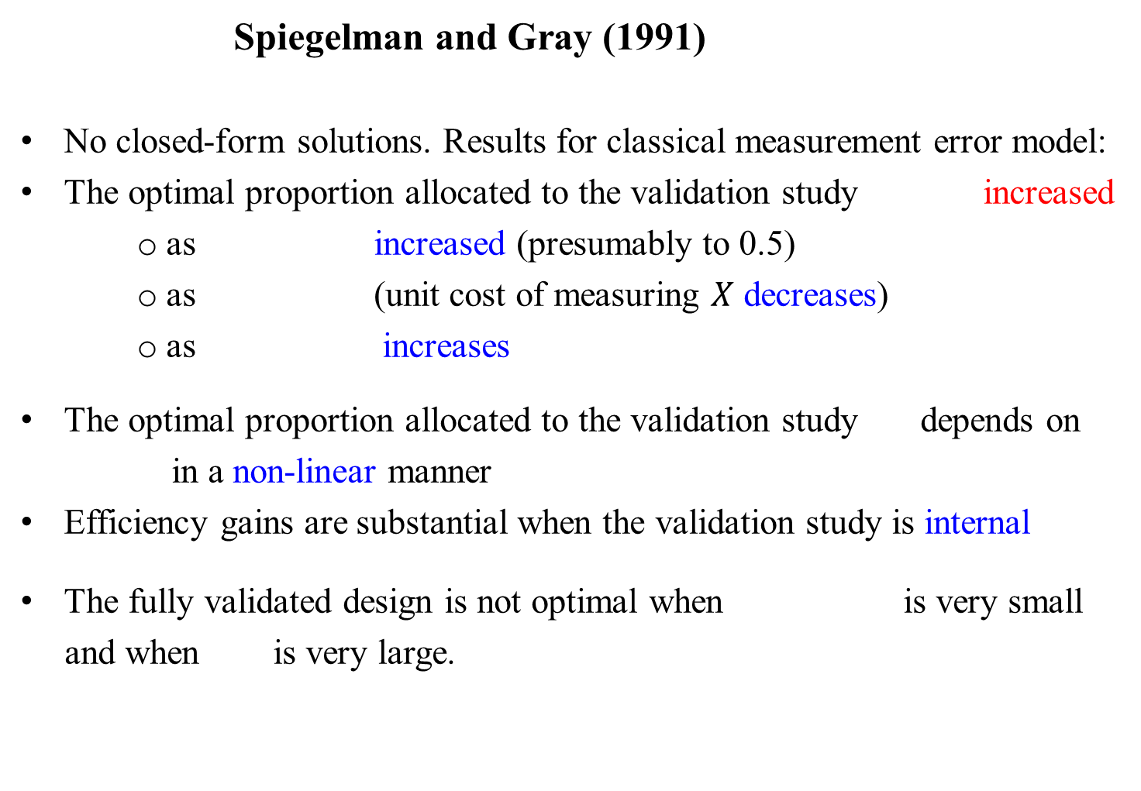
Spiegelman and Gray (1991)
No closed-form solutions. Results for classical measurement error model:
The optimal proportion allocated to the validation study increased
as increased (presumably to 0.5)
as (unit cost of measuring $X$ decreases)
as increases
The optimal proportion allocated to the validation study depends on
in a non-linear manner
Efficiency gains are substantial when the validation study is internal
The fully validated design is not optimal when is very small
and when is very large.
25
Notes:
25

Slide 26
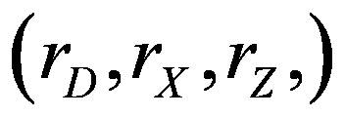
In this figure, and under classical measurement error model for MS/EVS design.
26
Notes:
26

Slide 27
 | MS Data | Method for dealing with ME | Measurement error assumption | Criteria of optimal design
Greenland (1988) | 2X2 table | Matrix method | Differential and non-differential | Minimize variance subject to cost considerations
Reilly (1996) | 2X2 table (and categorical exposure) | MLE | Differential and non-differential | Maximize precision for a fixed total budget or minimize the study cost given a desired precision
Buonaccorsi (1990) | Binary outcome, continuous E | MLE (Logistic regression) | jointly normal and homoscedastic | Minimize variance subject to cost considerations
Spiegelman and Gray (1991) | Binary outcome, continuous E | MLE (Logistic regression) | Classical additive ME | Minimize cost, subject to a specified discriminatory power
Rosner et al. (1992) | Binary outcome, continuous exposure | Logistic regression, Regression Calibration | Classical additive ME

Slide 28
Rosner, Spiegelman and Willett (Rosner et al., 1992)
Rosner, Spiegelman and Willett (Rosner et al., 1992) investigated
the role of (size of reliability study) and (number of replicates per participant in the reliability study) on the efficiency of the regression calibration estimates for the effects of systolic blood pressure (SBP), serum cholesterol (CHOL), serum glucose (GLUC) and BMI on the 10-year cumulative incidence of CHD, based on the Framingham Heart Study. There were 1,731 men in the main study cohort.
Rosner B., Spiegelman D., Willett W.C. (1992) Correction of logistic regression relative risk
estimates and confidence intervals for random within-person measurement error. Am J Epidemiol
136:1400-13.
28
Notes:
28

Slide 29




It is apparent that as increases,
the variances of the measurement
error corrected log relative risks
using regression calibration converge to an asymptote.
At small values of , larger
values of improve the
precision, but once is greater
than 100 or so, there is very little
advantage over .
$$n_{R_{I}}=2$$
$$n_{R_{I}}=3$$
$$n_{R_{I}}=5$$
$$n_{R_{I}}=10$$
29
Notes:
29

Slide 30
Concepts
Fully validated design
Optimal design
Unit cost
30
Notes:
30

